Slide 1
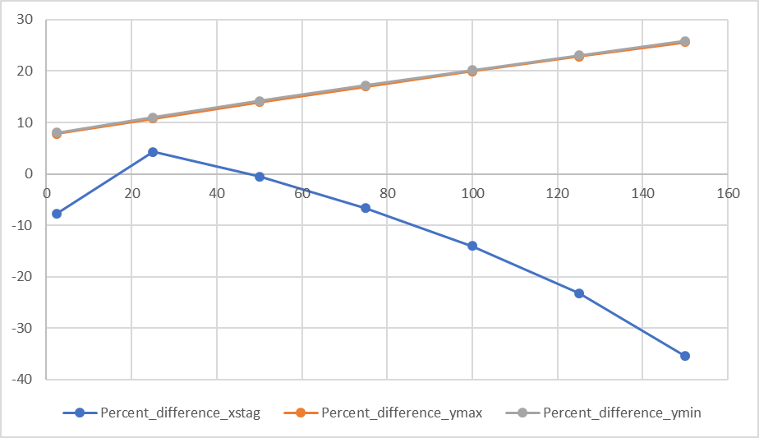
Change in percent difference with increase in pumping rate (2.5 gpm, hk = 10, gradient = 8.2E-06)

Slide 2
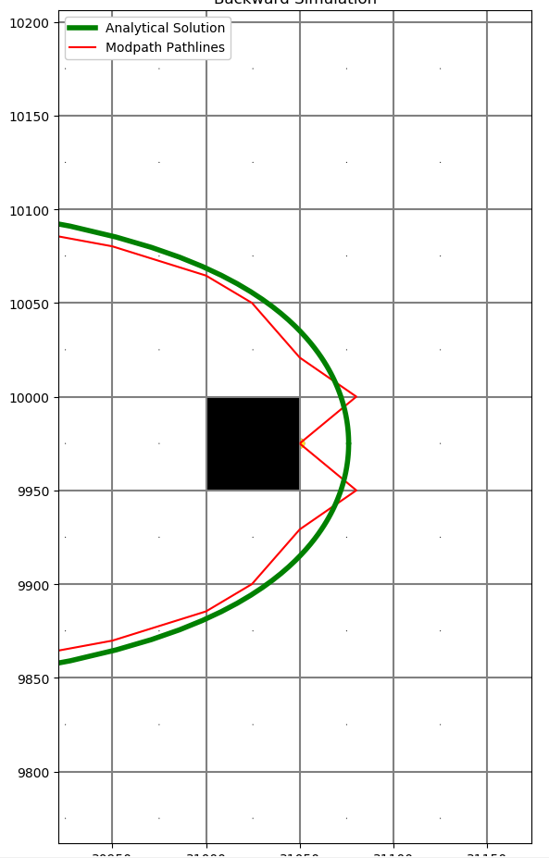
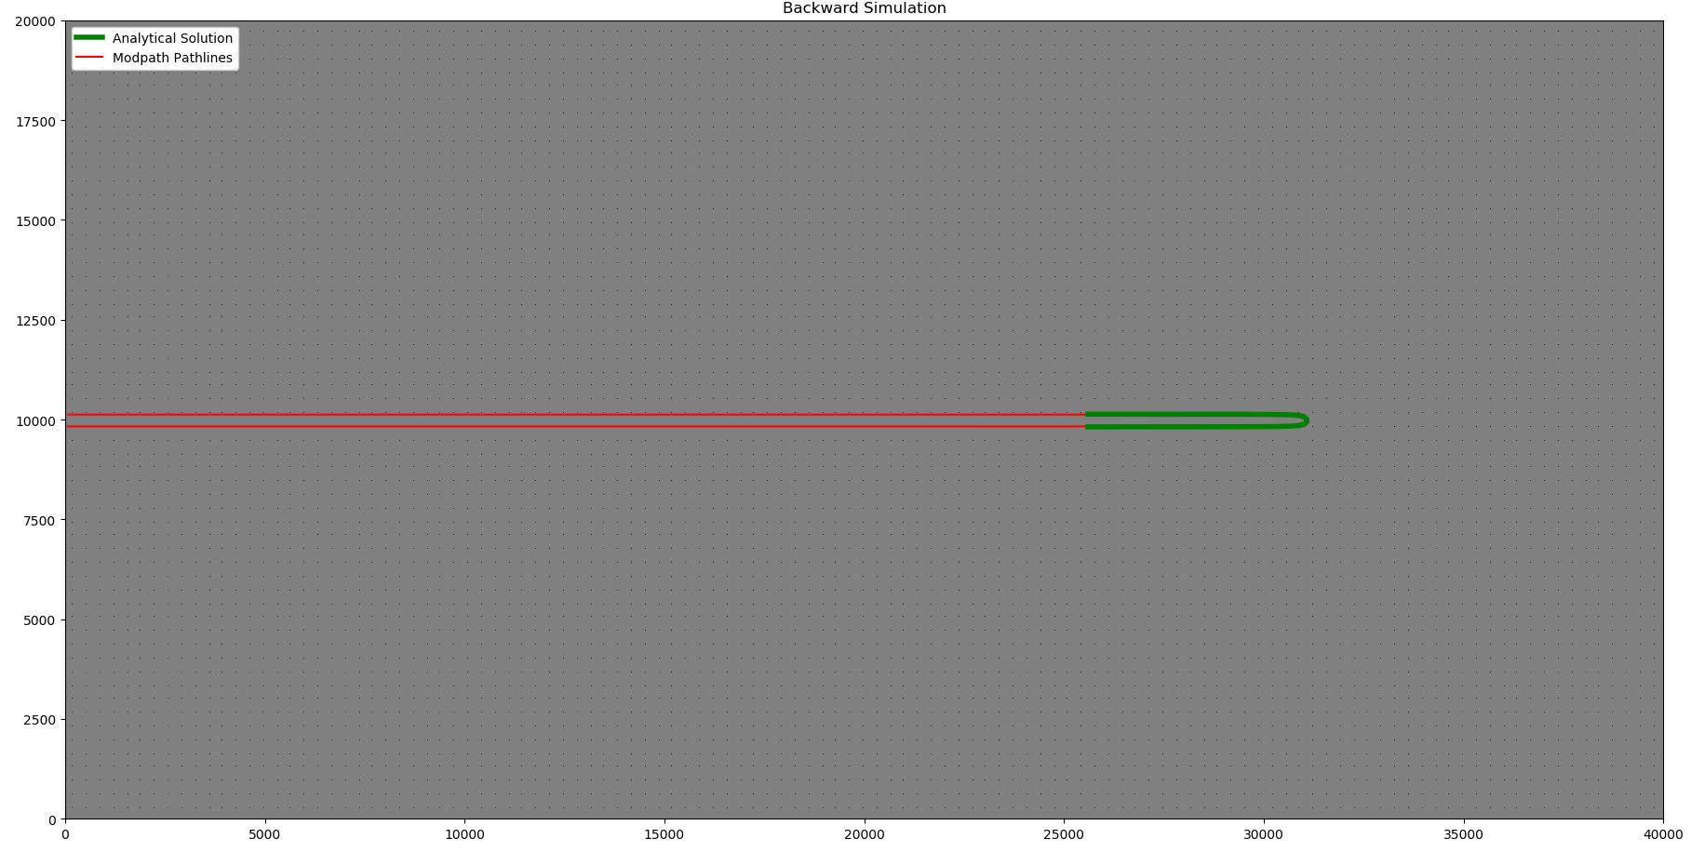
2.5 gpm, hk = 10, gradient = 8.2E-06

Slide 3
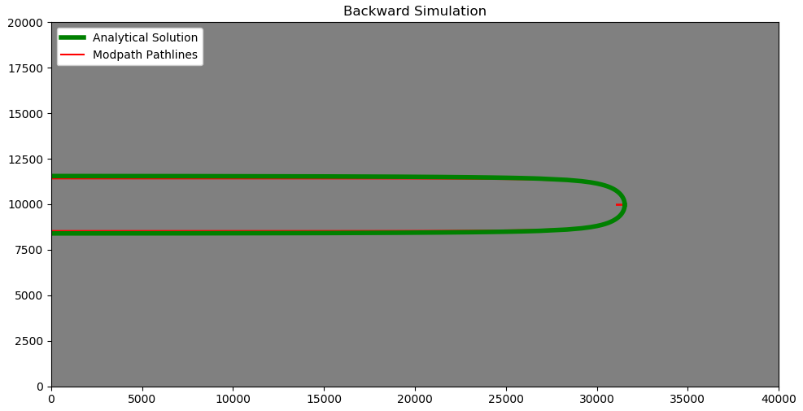
25 gpm, hk = 10, gradient = 8.2E-06

Slide 4
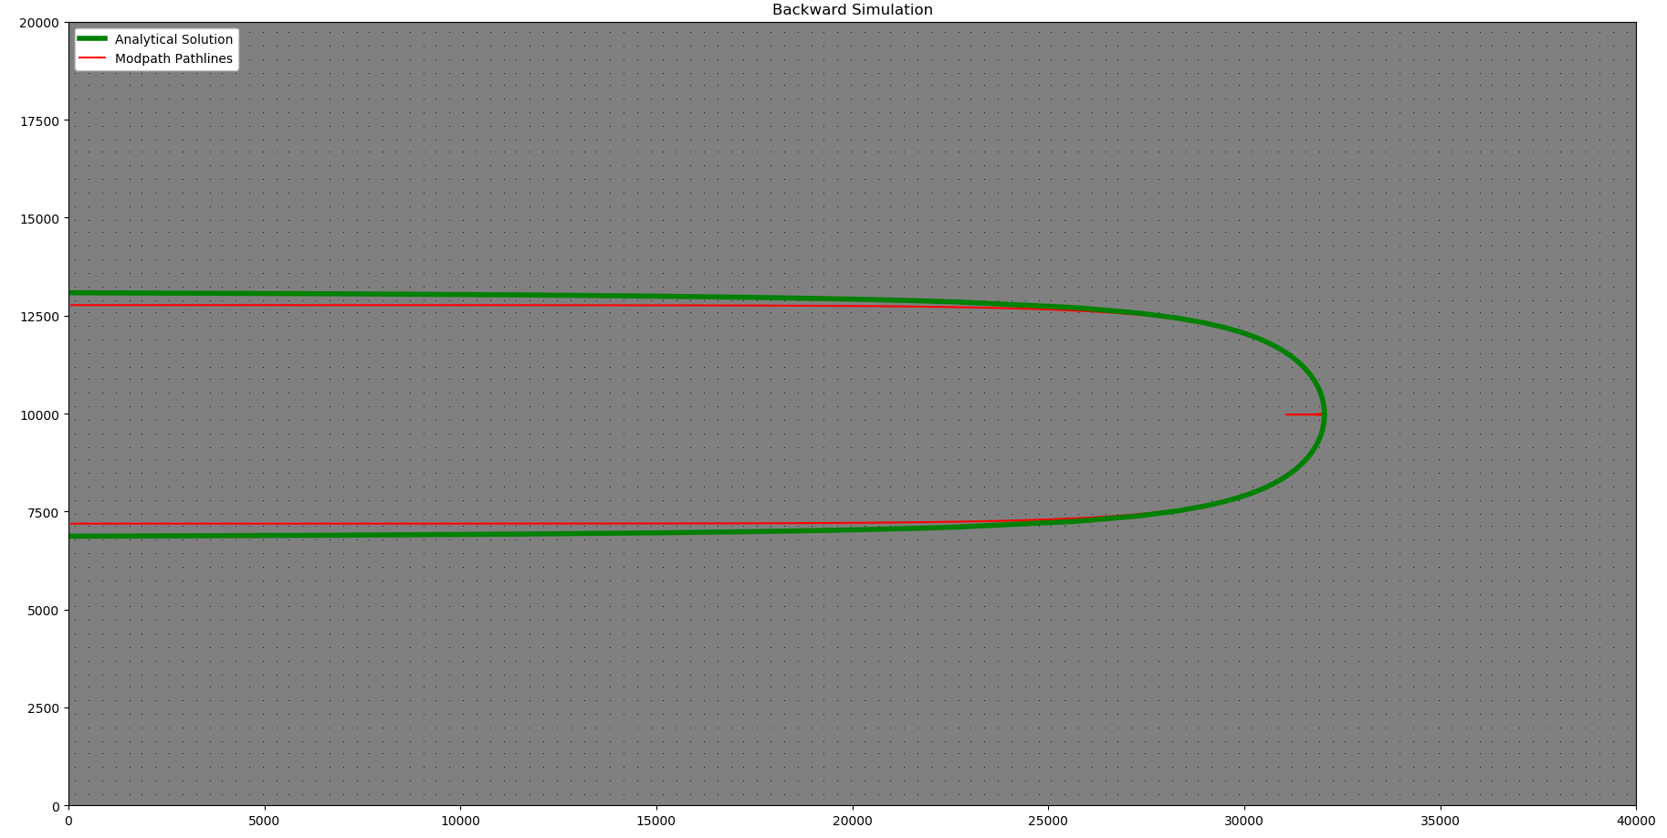
50 gpm, hk = 10, gradient = 8.2E-06

Slide 5
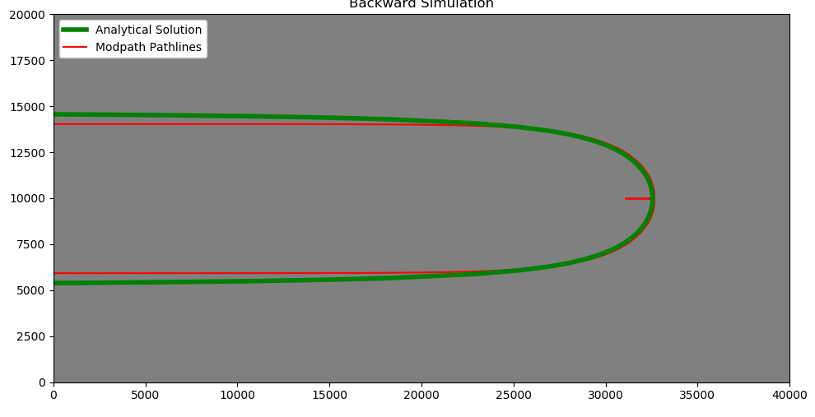
75 gpm, hk = 10, gradient = 8.2E-06

Slide 6
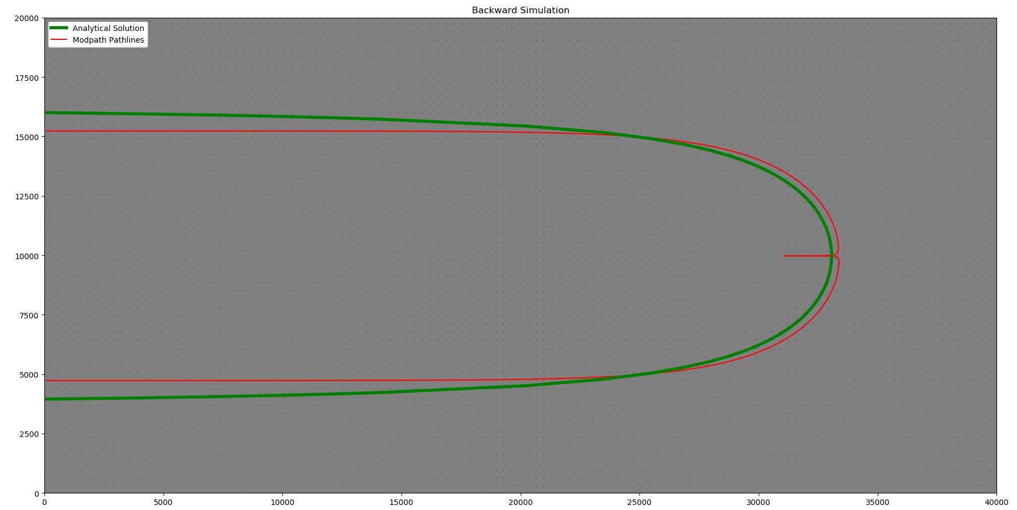
100 gpm, hk = 10, gradient = 8.2E-06

Slide 7
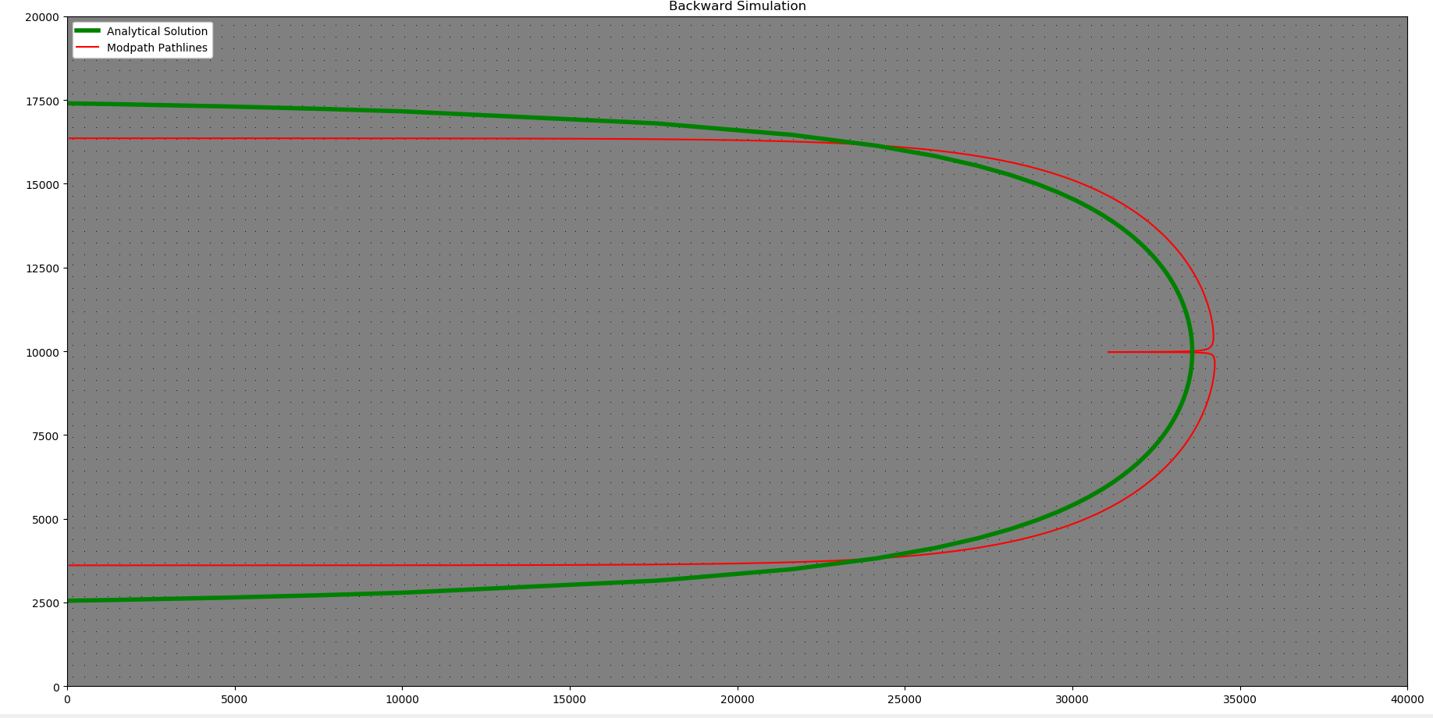
125 gpm, hk = 10, gradient = 8.2E-06

Slide 8
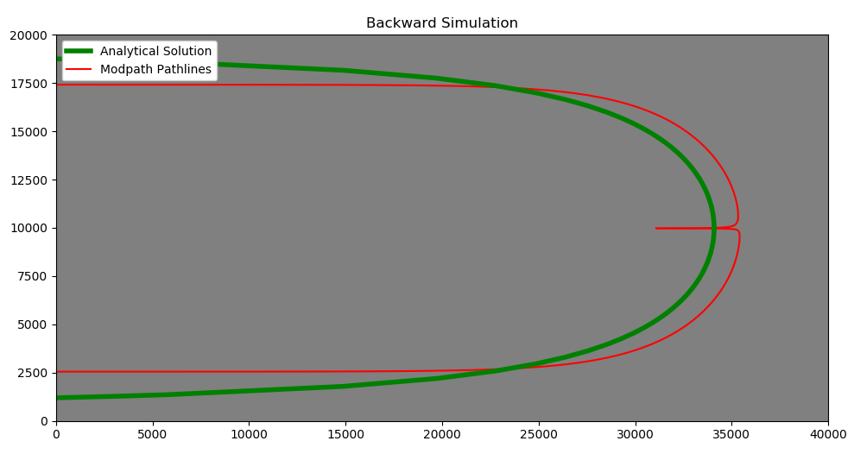
150 gpm, hk = 10 ft/d, gradient = 8.2E-06

Slide 9
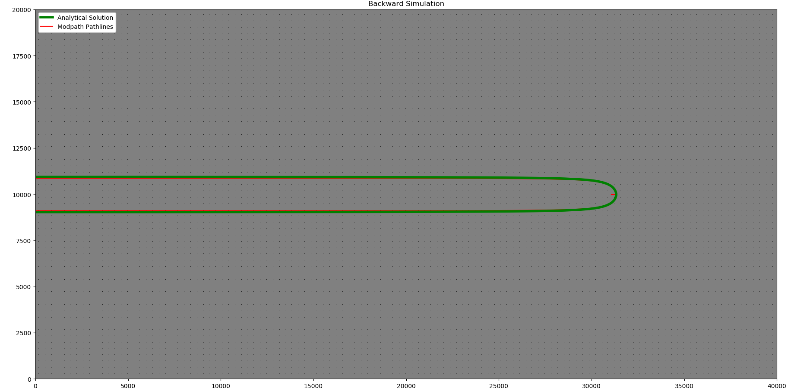
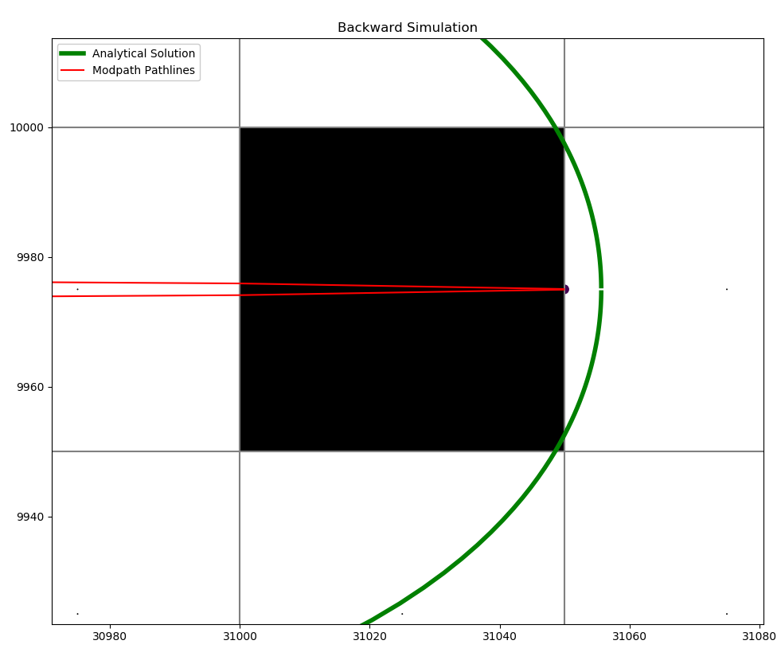
150 gpm, hk = 100 ft/d, gradient = 8.2E-06

Slide 10
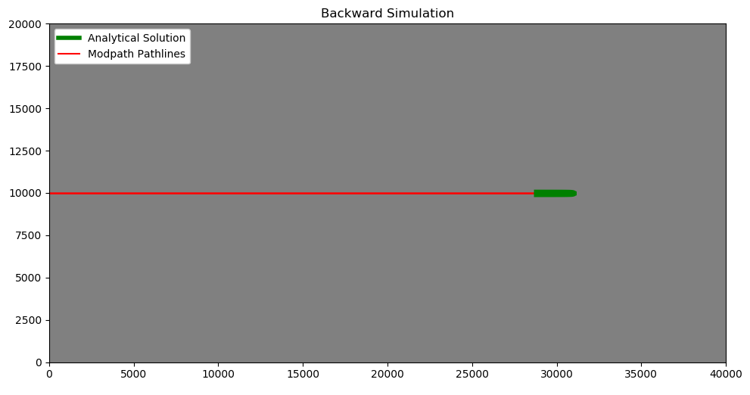
150 gpm at 1000 ft/day

Slide 11
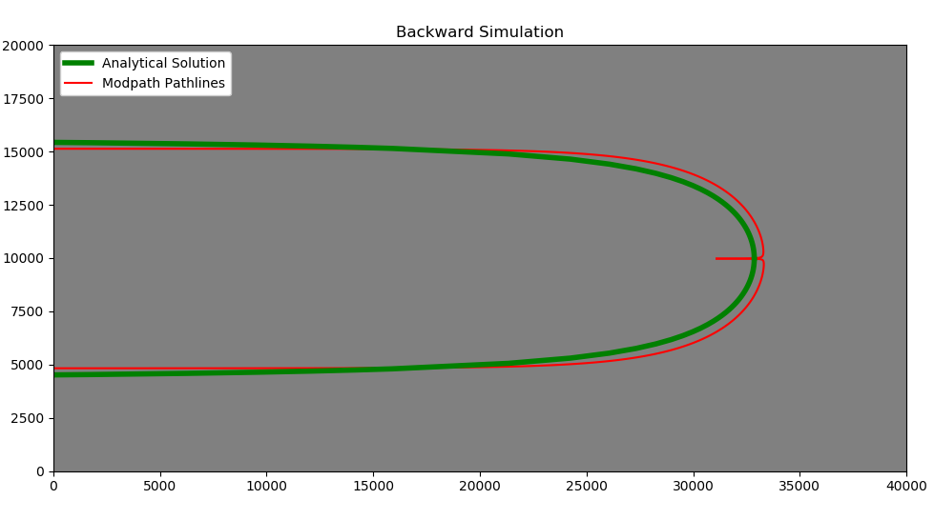
150 gpm, 1000 ft/d, gradient of 1.25E-05

Slide 12
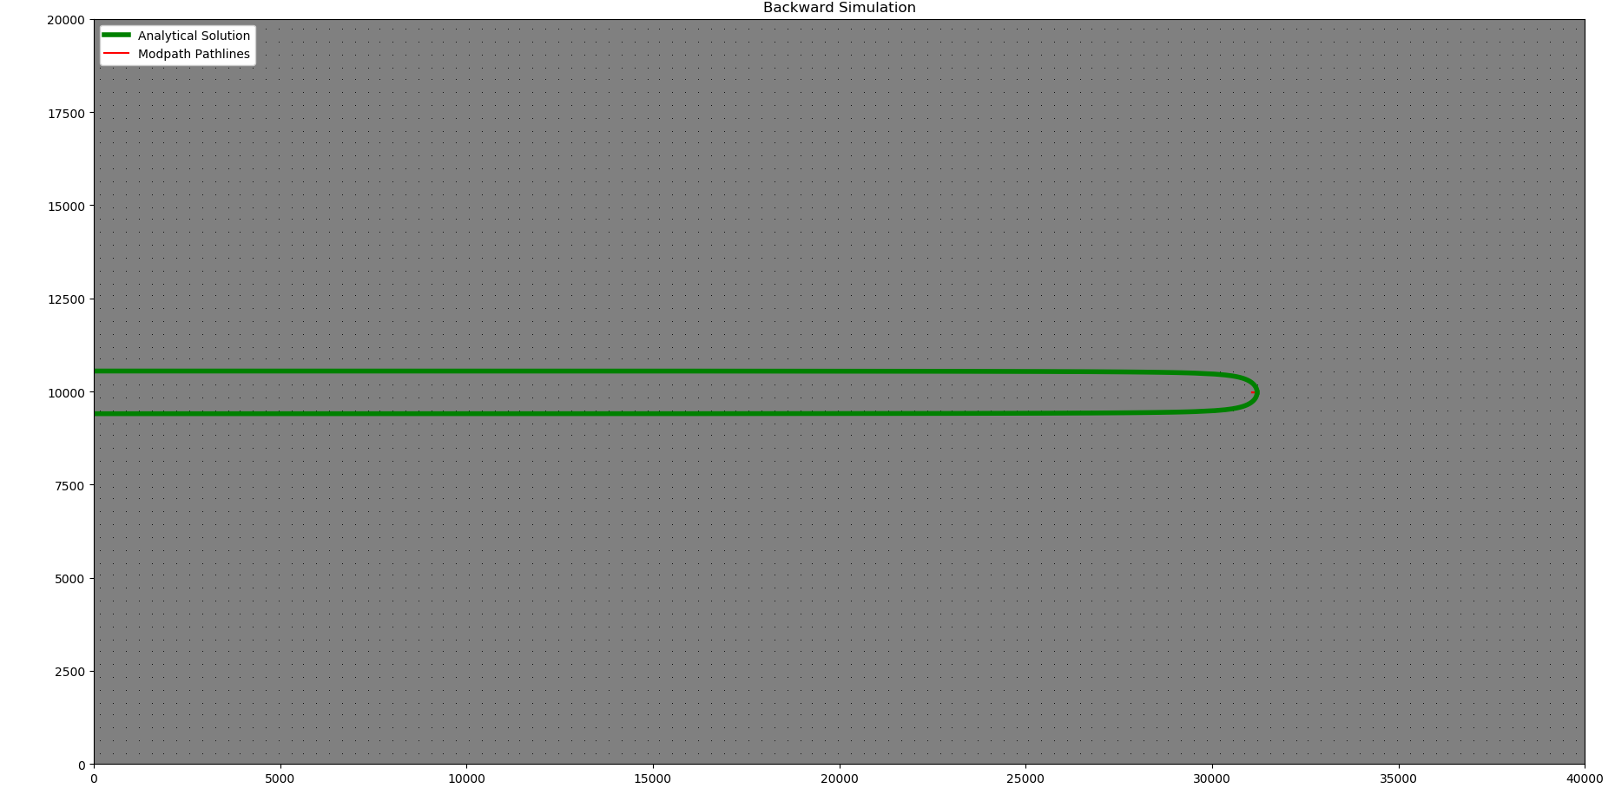
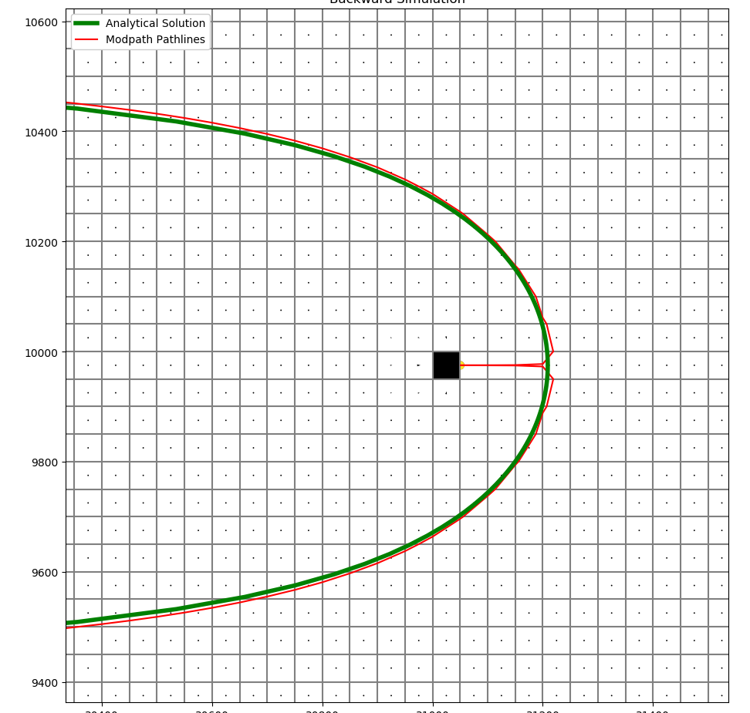
150 gpm, 10,000 ft/d, gradient of 1.25E-05

Slide 13
